Slide 1
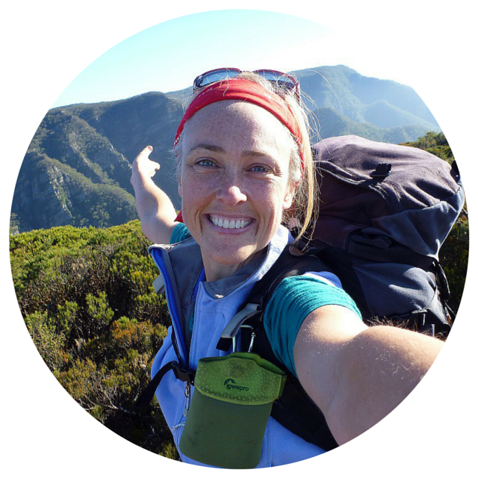
Caro Ryan
lotsafreshair.com
youtube.com/lotsafreshair
@lotsafreshair
Member of:
Bushwalkers Wilderness Rescue Squad
Sydney Bush Walkers Club
NPA
Notes:
Thanks. Really excited to share tonight. Thanks for the opportunity. Little bit of background - I'm a big fan of bushwalking clubs. I'm a member of Sydney Bush Walkers club (who through my membership with them, essentially changed my life) and BWRS, as well as keeping up a membership with NPA. Just before I start, I want to mention something about SBW. In the past, they've been accused of having a bit of an ego problem and if that is the case, I want to apologise. In the end I don't see there as being any club that is better than others - we are all in the same business, that of encouraging and getting people outdoors. We are all a little bit different, with different styles and ways of doing things, different demographics, but we are all here for the same reason. That's why I'm also a member of NPA... although I don't walk with them so much, I like to have a club that I can recommend to friends who might not be interested in harder walks and NPA have a great diversity of levels to suit everyone.

Slide 2
Issues Facing
Bushwalking Clubs
Notes:
It's been a while since I was on the committee of SBW, but I had a hunch when I started putting this talk together, that not much has changed in the issues that face clubs today. So just as a litmus test, I put it out to my Facebook page to see if that was still the case.

Slide 3
Are clubs relevant?
Notes:
One of the big questions addresses whether or not we're still relevant and can offer something to people who want to get out and have adventures in the outdoors. There are questions from expats coming from overseas (like Yersin here, who I met on a commercial trip on the Larapinta last year and convinced to join SBW). They don't come from a culture where clubs are a good way of learning of new areas or going great places. These are countries who have a solid tracks/hut system in place.
In the end, we need to understand that clubs aren't for everyone, not everyone is a joiner and we shouldn't waste our time trying to market and reach people who will never be convinced about the benefits of clubs.
Rather, we should know who and where the people are who COULD be convinced and focus our energies to messaging them.

Slide 4
Notes:
Here's this old chestnut. Attracting new members and then convincing them to stay. Not only stay, but become involved, committed and contributing members... developing them as leaders. As conversion rates from new member to committed member, to leader drop with each step... this is where going for quantity as well as quality can help.

Slide 5
Notes:
And this... how easy are we making it for someone to join our ranks.
If I look closely at Heather Boyd here (Ok, so I did a bit of Facebook stalking and looked at her profile), she looks like EXACTLY the type of person we'd love to have join our clubs... so why do we make it so hard for her?
Q: Who's club does not have an entrance criteria or prospective member hoop to jump through?
Q: Does your club allow for people to join online?

Slide 6
Sydney Bush Walkers Club 2015
833 Members (Female 387, Male 446)
250 Prospective Members
25% Conversion to full member = static membership
Notes:
So, you may have heard of the changes that happened to Sydney Bushwalkers Club over the last 6 years or so.
Let me give you a snapshot of where the club is now and how we got there.
We have a 12 mth Prospective Membership system, where people need to to 3 walks (2 day, 1 overnight and pass some basic bushcraft, navigation and first aid training) to become fuill members.
Although 25% is a good healthy conversion rate, it still means that we are in a state of static membership due to 'natural attrition'... the death of older members or people leaving for other reasons.

Slide 7
20s 61
30s 135
40s 147
50s 172
60s 112
70s 46
80s 6
? 154
Median Age 51
Male 55
Female 46
Tiggers Email List
266
Notes:
Tiggers is a social sub-group of SBW. Nominally for people in their 20s and 30s, however you can see by the numbers that there's obviously a few people in their 40s (me!) who manage to still be on the email list.

Slide 8
How Active Are Members?
Walks/yr % Comment
12+ 11% > 1 walk per month
8-11 6% 2 walks per quarter
4-7 14% 1 walk per quarter
1-3 36% < 1 walk per quarter
0 33% Nada, null, zilch!

Slide 9
Leaders & Activities
75 leaders
451 walks to date in 2015.
Top 12 leaders led 50% of the walks.
Notes:
As with most clubs or organisations, you can see that the bulk of the work is still done by a small core group of people.

Slide 10
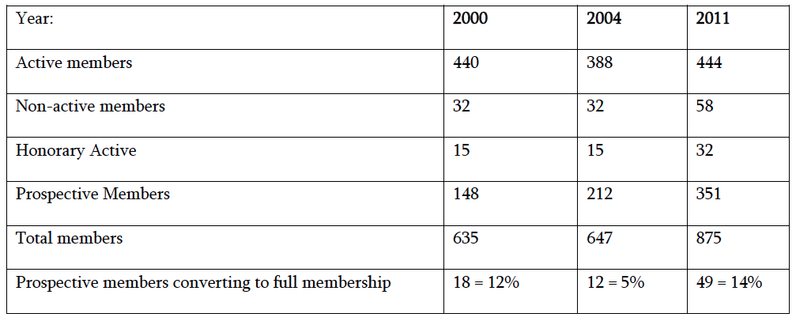
Notes:
Here's a look at where we were in 2000-2004. As you can see, not a great change in our membership numbers. But looking at 2011, there's a fairly big change. So what happened between 2004 and 2011?

Slide 11
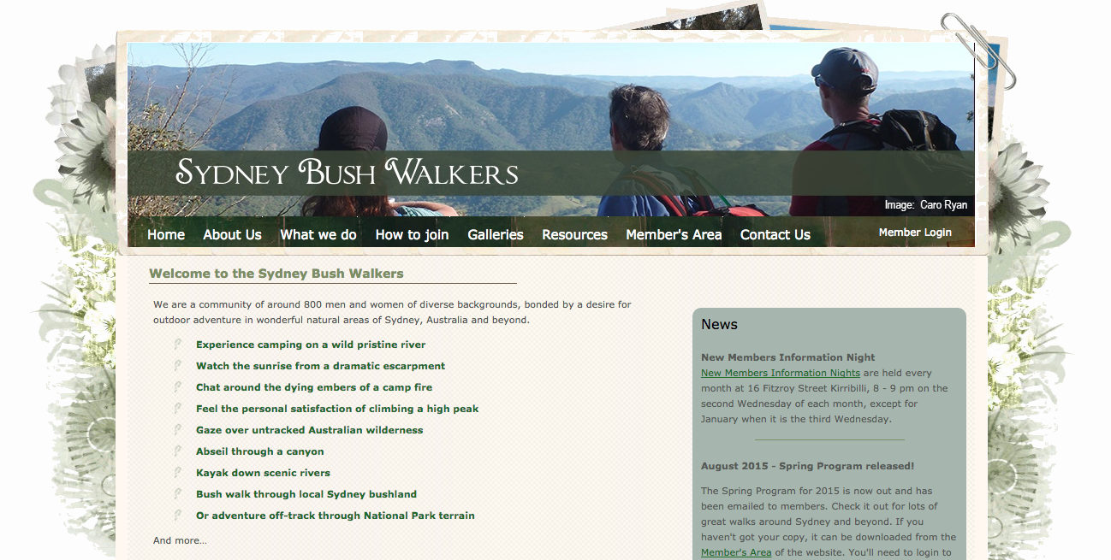
2009
Notes:
In 2009, I run a new website project for the club. At the time, I wasn't on committee as I feel that sometimes, you can achieve more by NOT being directly involved, but running things from the sidelines.
Some might think of it as a Fletcher Christian mutiny, but it was anything but.
SBW changed my life - I loved my club, however I was watching and seeing a negative pattern starting to gain momentum in terms of the aging population and lack of new members. I see things through the eyes of someone who works in the marketing and communications field (I'm a producer - I run a production company) Unless something drastic was done, we'd keep spiralling down. I didn't want to see the end of this club I loved, with all its history and foibles, end in nothing.
I came to the Comittee with a proposal. I proposed that I would finance and project manage a new website for the club on the proviso that if there was any in-fighting, politics or arguments, I would pull the pin.
Everything would be done in a way that allowed for Committee approvals, feedback and signoffs, so I wasn't acting as a lone ranger, but I meant business and I wasn't prepared to invest my money and my significant time in running this project unless I could be guaranteed success without barriers.

Slide 12
What did we do?
Professionally produced (Design, UX/Navigation, SEO)
Brand
Images (like attracts like)
Emotive copy - experience based
Consistent
Facebook Page (795 likes as at today)
Niches : Tiggers, Women
Made it easier to join - Centennial Park Training
Leaders Pathway
Notes:
We did a number of things along with the website development.
Firstly, I ensured that the website was done professionally, by people who's job it is to do this. Not someone's nephew, son, sister, etc who is 'good with IT'.
Websites need 3 things to be done to be successful.
1. Professional graphic design (how it looks, fonts, colours, imagery)
2. UX = User Experience and navigation. How does it behave, is it easy to find things, is it logical?
3. SEO = Search Engine Optimisation. So when someone types in "Bushwalking Sydney" to Google... you appear in the top 3...or at least the first page.
One thing that I don't take for granted is our club's name. "Sydney Bush Walkers club", makes our job with SEO a little bit easier. I'm encouraged to hear that Mt Druitt Bushwalkers are currently going through a name change. I think it is easier for clubs with a generic name (not geography based) to market themselves. Their audience is automatically so much wider.
I looked at the Brand of SBW. What message are we wanting to communicate about who we are, what we do?
Images. I used photos of the youngest people in the club... at the time, I was the youngest... so I purposefully put on walks and took photos of other 'youngish' types to populate the website with.
The copy/text appealed to the emotive side of people. eg: experience camping on a wild pristine river.
We went for consistency across all our communications of our look and feel "our brand" that was developed for the website. We wanted to present a professional image... we aren't 'amateur' bushwalkers, we didn't want an image that looked amateaur.
We jumped into social media with Facebook. Page NOT Group... sharing our photos and some of our community chat with the general public... giving them an insight into our world...
We looked at the different niche groups and how we could service their specific needs and speak THEIR language. Tiggers (from the word Tiger Walkers) was a social group designed to give social proof to people in their 20s and 30s that there ARE other people like THEM in the club. They may not see them on every walk, but they can get together at the pub and talk about the walks program and all decide to go on specific trips together. Women, I ran some Women's Only walks designed to encourage women to gain confidence in their skills and become leaders. I also ran some fringey "Silent Walks", which appealed to the quieter, less 'joiner' types who were drawn to the bush for solitude and meditation.
We removed the barriers to joining, by making it easier. Rather than having to complete the entrance quizzes on walks, they can now come to Centennial Park 4 times per year to learn (and be tested) on the 3 areas of bushcraft, first aid and navigation.
We developed a Leaders Pathway with training, support and mentoring.
However...

Slide 13
2015
This is a bad website
Notes:
This is now a bad website... let me show you why.

Slide 14
Once upon a time...

Slide 15
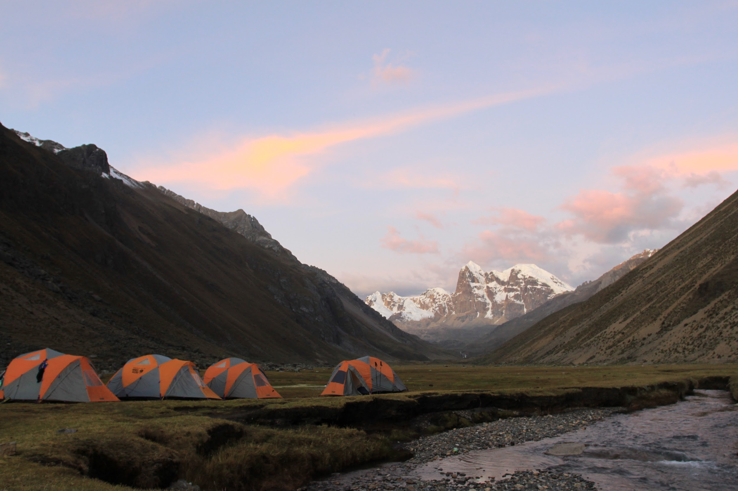
Notes:
If you've ever travelled overseas...

Slide 16
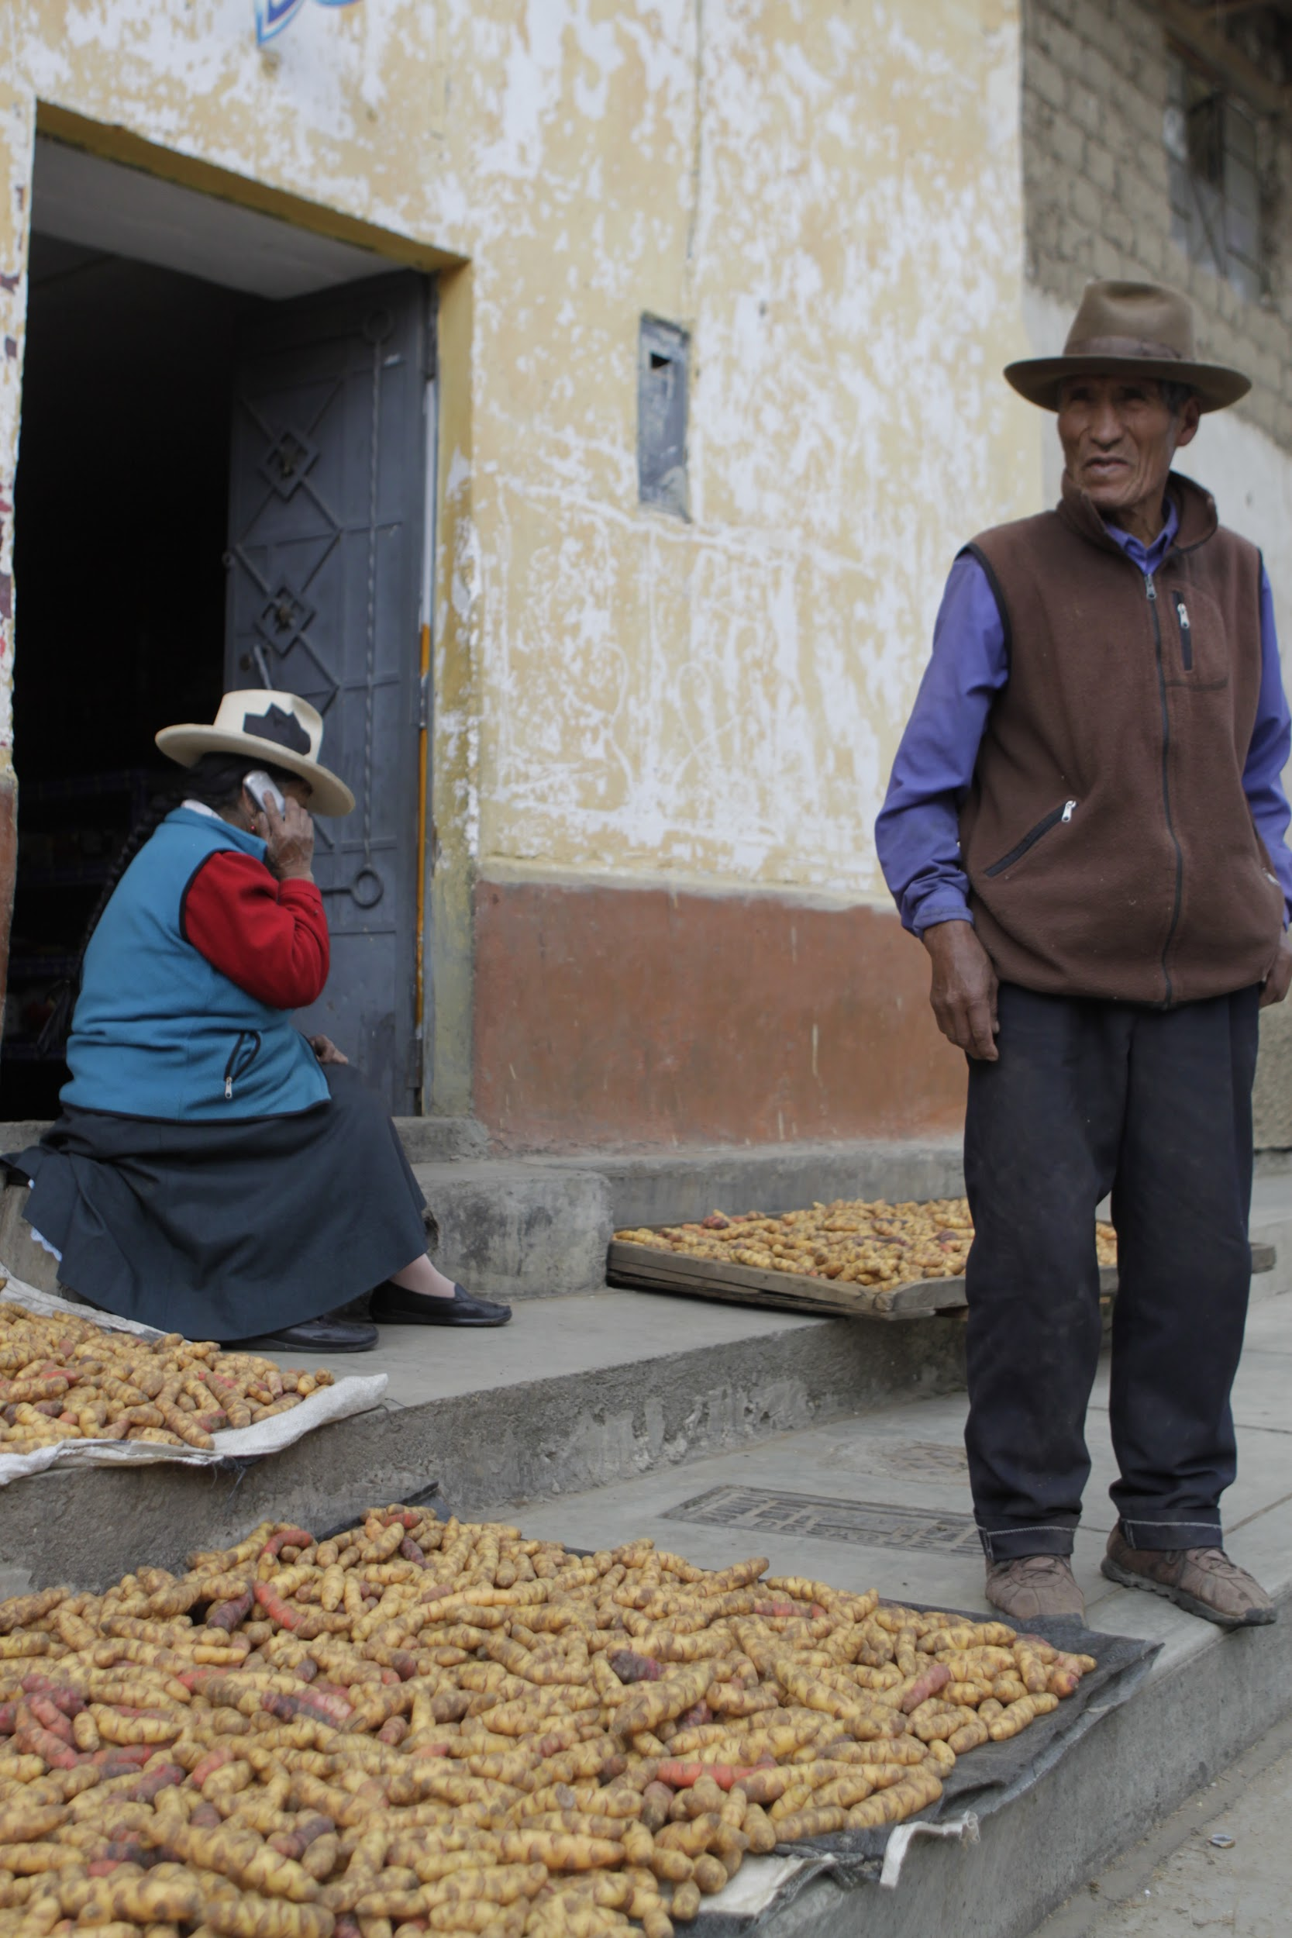
Notes:
In places where you don't speak the language, there is always going to be a challenge about what you are trying to say versus, what the person you're speaking with THINKS you're saying.

Slide 17
Carne?
Notes:
I was in Lima, walking through the backstreets looking for something to eat. We came across this wonderful smelling roadside stall/BBQ that was cooking meat that was slathered in marinade. In bad Spanish, we asked, Carne? (Beef? Meat?)

Slide 18
Si, carne.

Slide 19
Carne?
Notes:
Unsure, but enjoying the delicious flavour, we asked again.

Slide 20
Si, carne.

Slide 21
Si, carne. :-)

Slide 22
Carne?
Notes:
The issue however, was that I was asking the wrong question… I should have been asking…

Slide 23
Cojones?

Slide 24
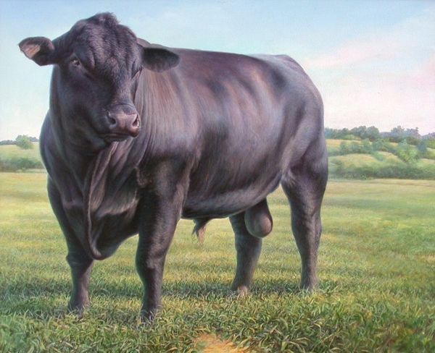
Notes:
Yes, Cojones is beef/meat... but it's a particular kind of meat.

Slide 25
Notes:
The problem I had lay not only in the question that I was asking, but in the language barrier. We spoke a different language. We need the balls to learn a new language.

Slide 26
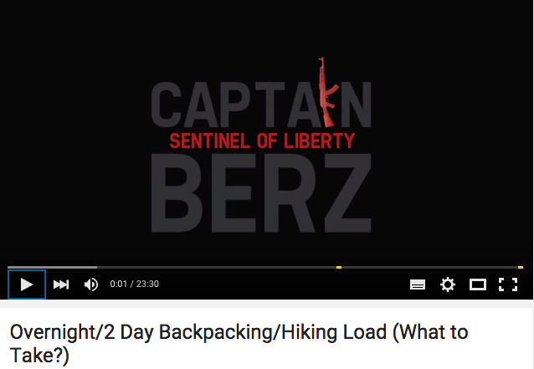
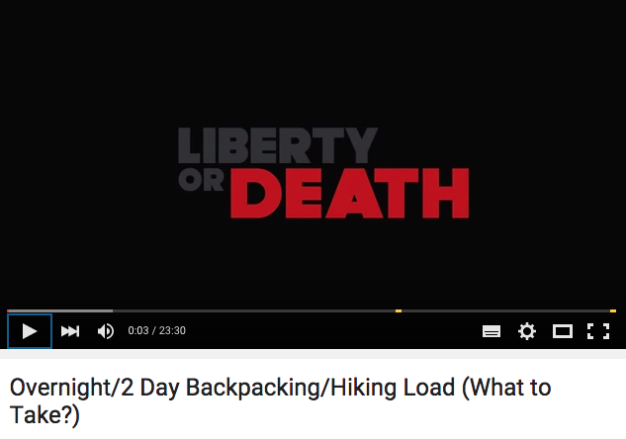
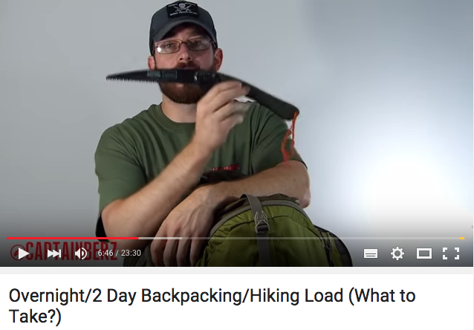
Notes:
The reason I started Lotsafreshair, was because when I went looking on YouTube to find How To videos… no one was speaking my language.
At the time, I thought about all the things I'd learnt at SBW and wondered how someone who didn't have the luxury of a club, (or didn't want to join a club) would learn what I did.
Google is the obvious place. It's where everyone goes to ask the questions they're too afraid to ask in public.
What I found was things like Captain Berz and his big knife. Heck, I just wanted to learn how to pack a backpack for an overnight trip, I didn't want to join a battle.
I felt alienated and he was definitely speaking another language.
I thought that if that was the only story being told, I'd probably be put off for life.

Slide 27
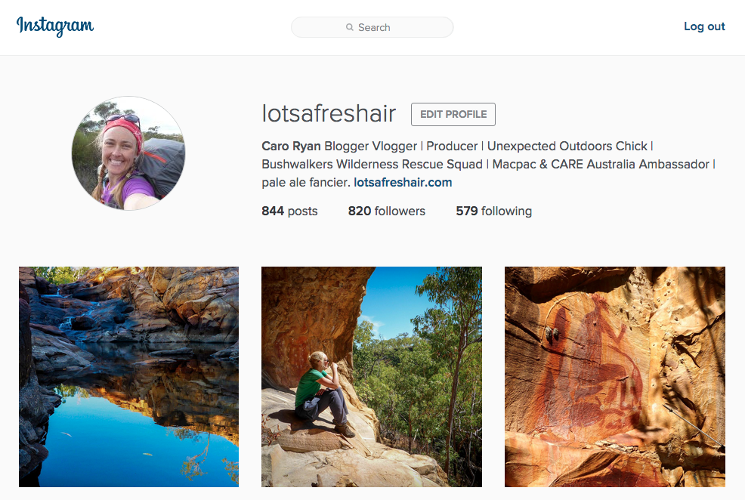
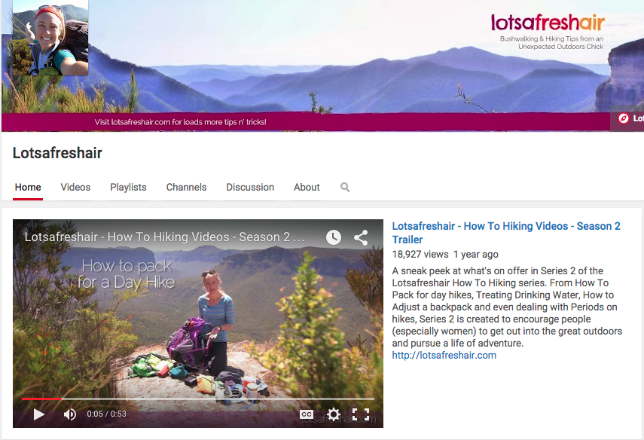
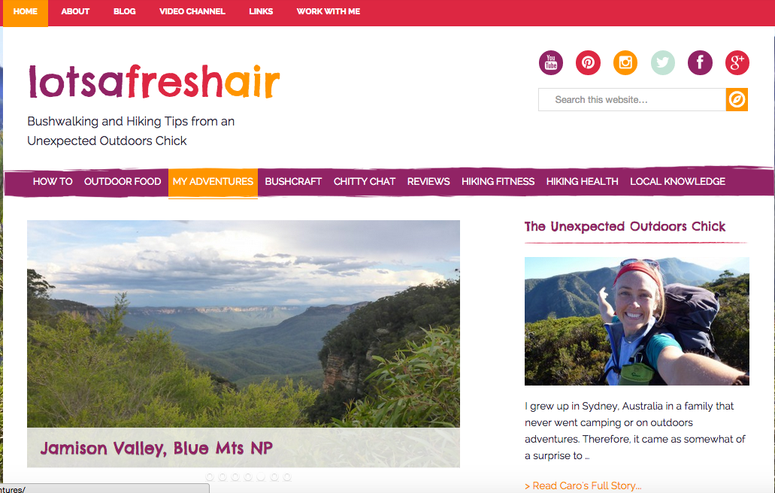
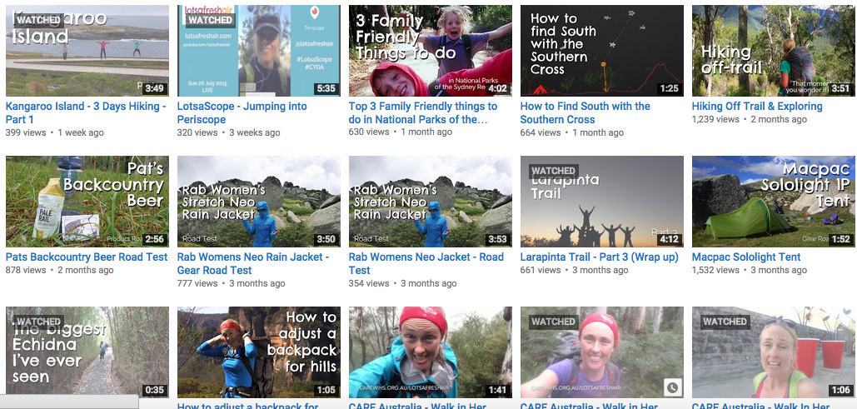
Notes:
That's why I decided to start the blog, channel and social media, to speak 'outdoors speak' in normal person language. In a way that aimed to encourage, inspire and equip (hopefully sometimes entertain), and remove all the barriers that people have to getting out bushwalking.

Slide 28
2014 World Parks Congress
Solutions for Inspiring a
New Generation
Notes:
Through the work with Lotsafreshair, I had the opportunity to speak a couple of times last year at the World Parks Congress. A massive 10 year conference with around 10,000 delegates from all around the world.
Both myself and Matt McClelland were speaking as part of the 'Inspiring a New Generation' thread. They've just released their summary of solutions and I'm going to share just 3 with you...

Slide 29
Find & share the fun in nature

Slide 30
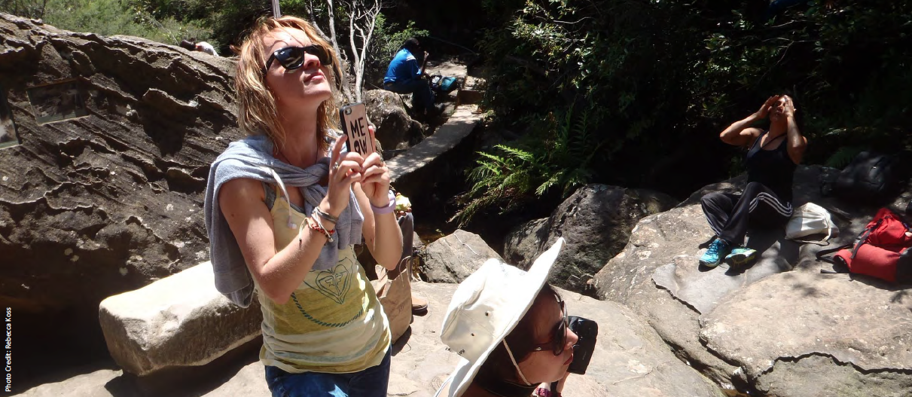
And enable young people to engage with nature on their own terms, creatively and unconditionally.
Notes:
Look at this young person... engaging with nature... with her smartphone. How would you make this person feel if they were on one of your walks. Would you encourage her to shoot and share photos in the bush? Follow the blue dot on Google Maps? Even share the experience live on Periscope?

Slide 31
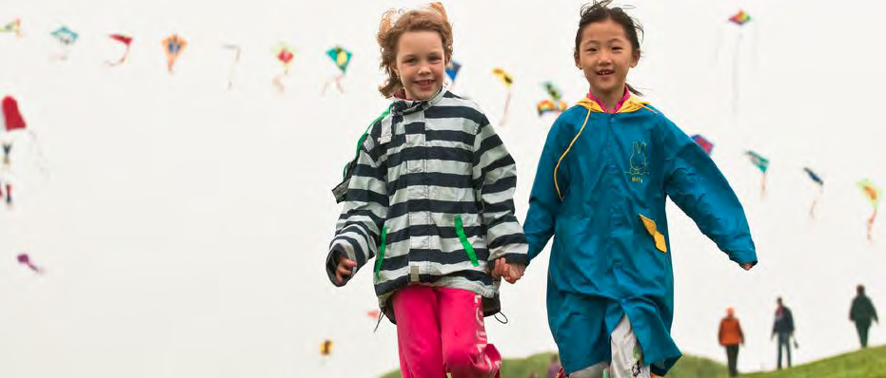
2. We must bring Children
into nature at an early age.
Notes:
I feel that clubs use the 'working with children' barrier as a poor excuse to avoid having family or children walks.

Slide 32
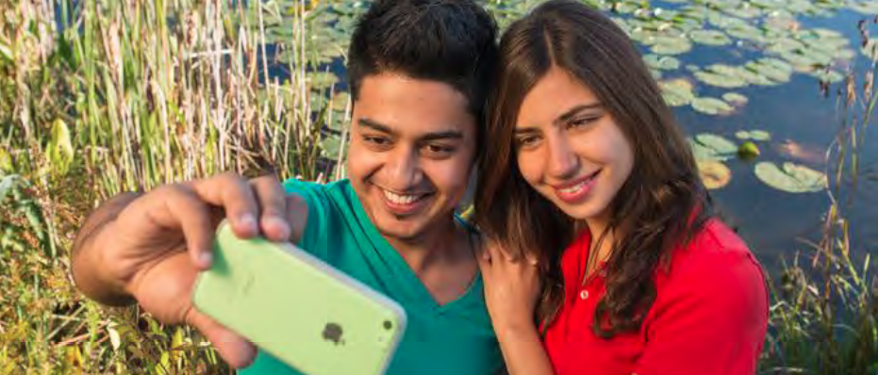
3. We must embrace technology as a means to connect young people and nature.
Notes:
Again, technology is key.

Slide 33
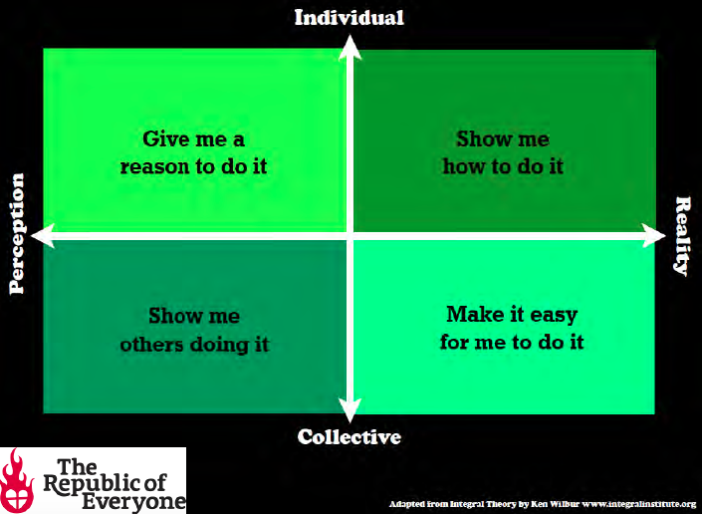
Notes:
As part of this, they brought up this "Integral Theory" quadrant, which I believe is a GREAT tool and should act as a checklist for us when we look at how we promote our clubs ... and bushwalking in general.

Slide 34
2015
This is a bad website
Notes:
Which brings me back to this... why is this a bad site?
Well, in 2009 it was fine. But it's now 2015 and the language that is being spoken online is very different and it's being spoken in different channels.
Yes, the internet is changing so fast that it's almost impossible to keep up... but if we are going to keep sharing the story that we (as clubs) are relevant, important and vital to the general public, we must keep evolving and learning to speak new languages as they emerge.
Let me show you the language that's being spoken now...

Slide 35
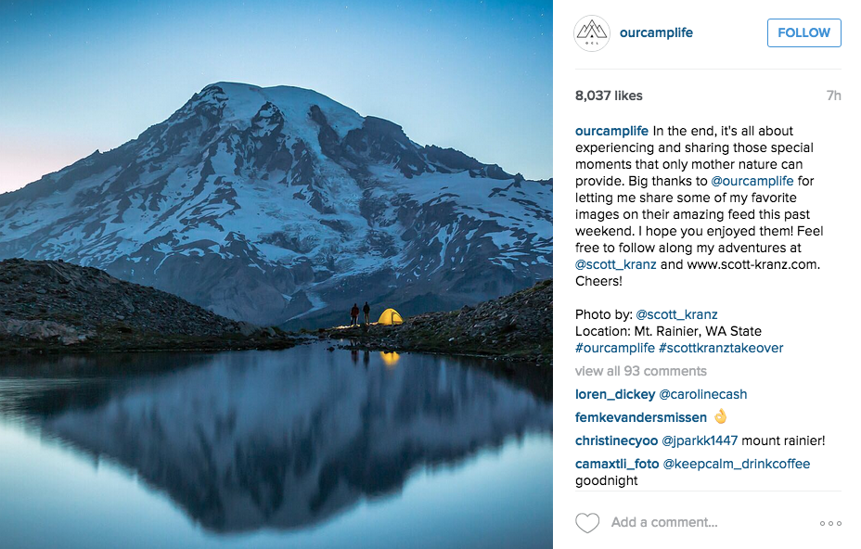
Notes:
Instagram. A purely visual social media.
Q: Is there any club that is on Instagram? {1}
But look at these images... there's something familiar about them...

Slide 36
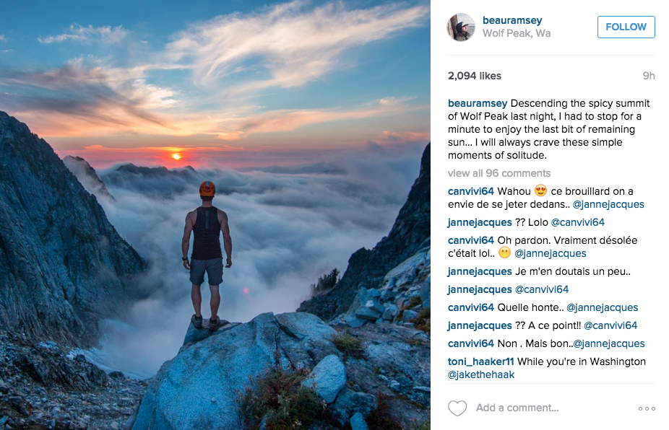
Notes:
Look. That could be any one of us... standing at the edge of Kanangra Walls in a misty morning... but it's not.

Slide 37
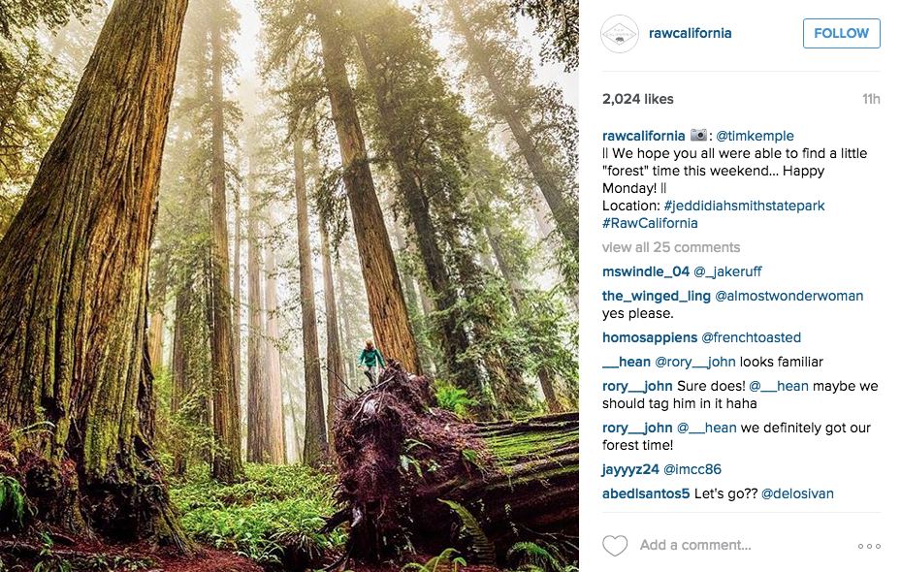
Notes:
Shots like this give such a sense of wonder and tell the story of connecting to something so much bigger than ourselves.

Slide 38
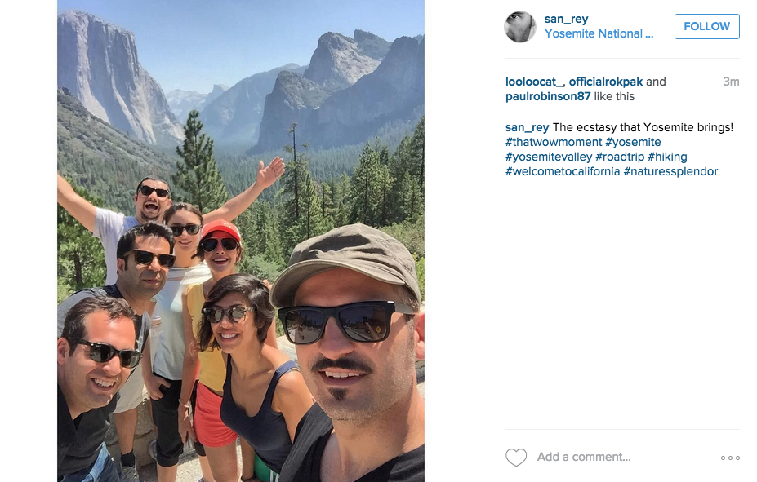
Notes:
... and showing happy, healthy, people out there... feeling part of nature and importantly... part of a tribe of like minded people.

Slide 39
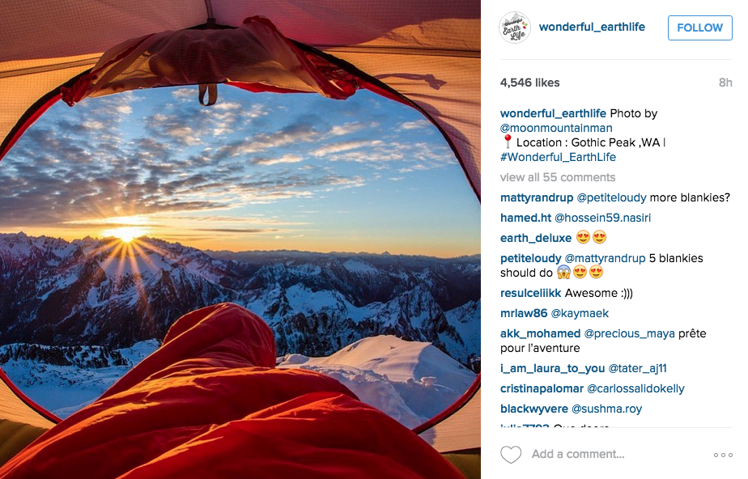
Notes:
This is inspirational.

Slide 40
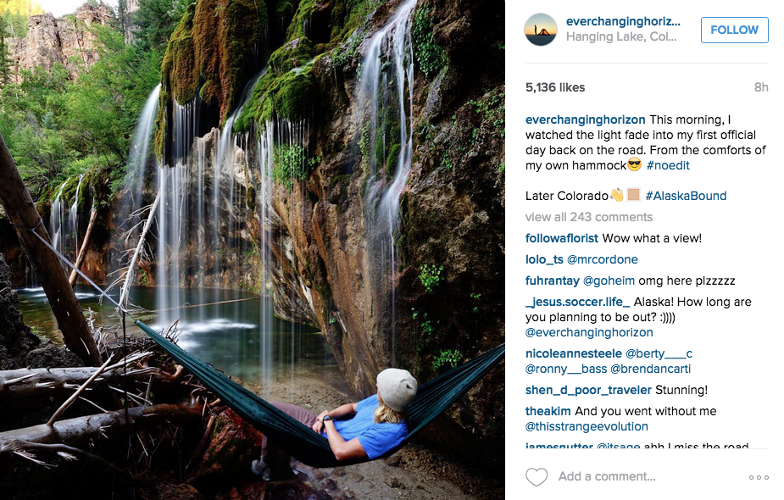
Notes:
Or this... I'm not a hammock person, but this could convince me to be.

Slide 41
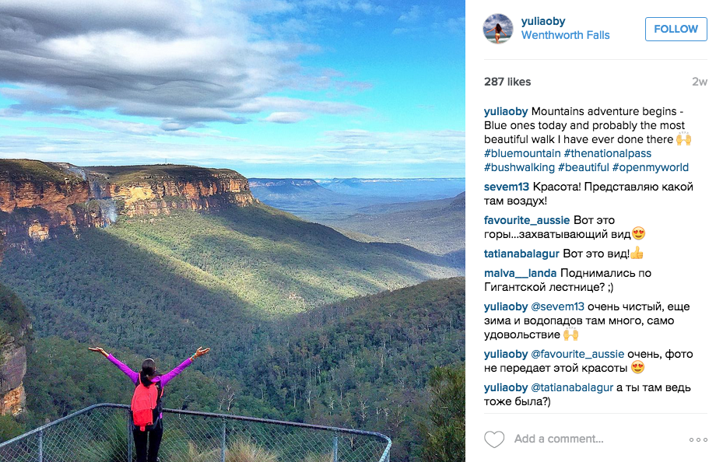
Notes:
Or closer to home, here's a Russian woman who lives in Sydney...

Slide 42
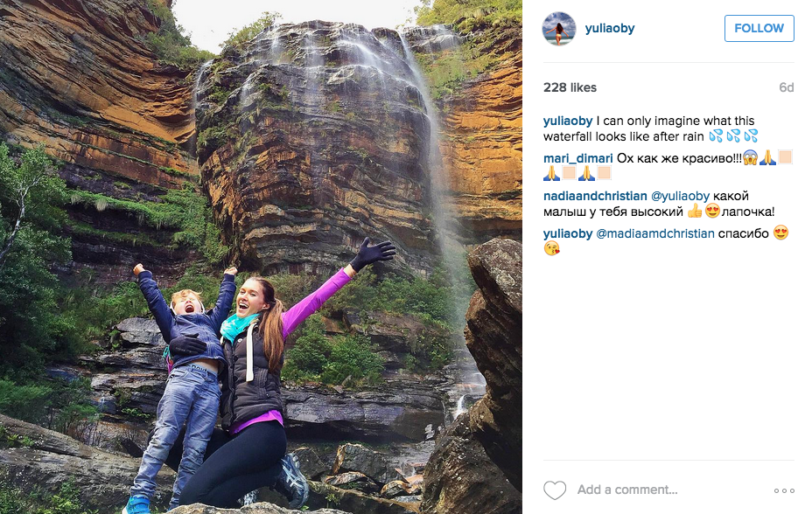
Notes:
... and with her daughter at Wentworth Falls.

Slide 43
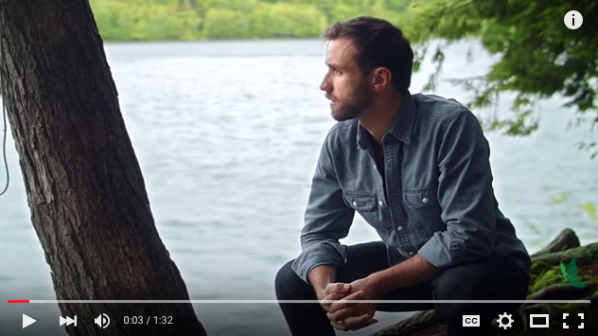
Notes:
And for something a little quirky... there's great content that is being created by other people (ie. you don't have to pay for it!!) that you can share. By sharing it, it says something about your brand and can help you. It's a resource that you can use and the internet has lots of it.
I've created a STACK of How-To videos and blog posts, packing lists and all sorts of things on lotsafreshair.com and youtube.com/lotsafreshair that you are all encouraged to use and share.

Slide 44
“Bushwalkers
have great stories to tell.
Let’s tell them in a
language people understand
and in a way that inspires them.”
Notes:
In closing, I really believe that we have AMAZING stories to tell, all we need to do, is to evolve our language to tell them in meaningful ways that will connect with people.
And WE should be the ones to learn a NEW LANGUAGE, because our need is greater...

Slide 45
Do you have
the cojones?
Notes:
We need the balls to learn a new language.

