Slide 1
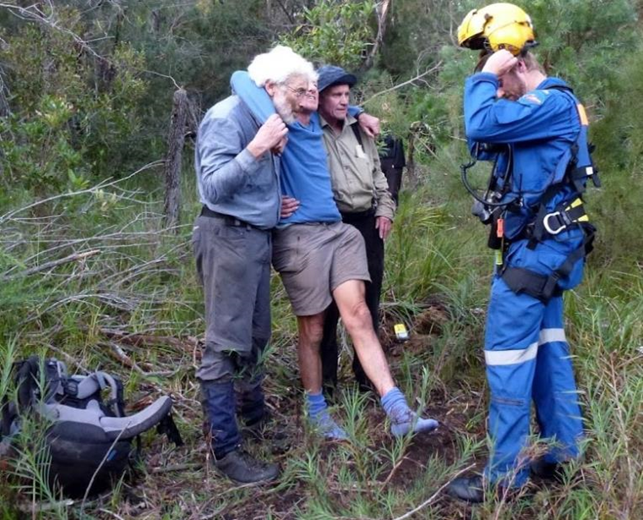

Risk Management Guidelines

Slide 2
Aims
To help Clubs provide participants with an experience that is as safe as reasonably possible
To help demonstrate to our insurer that Clubs are managing risks competently, to keep premiums down
To persuade the small number of Clubs that presently put less effort into risk management, to increase their effort, and to use standardised procedures and forms.

Slide 3
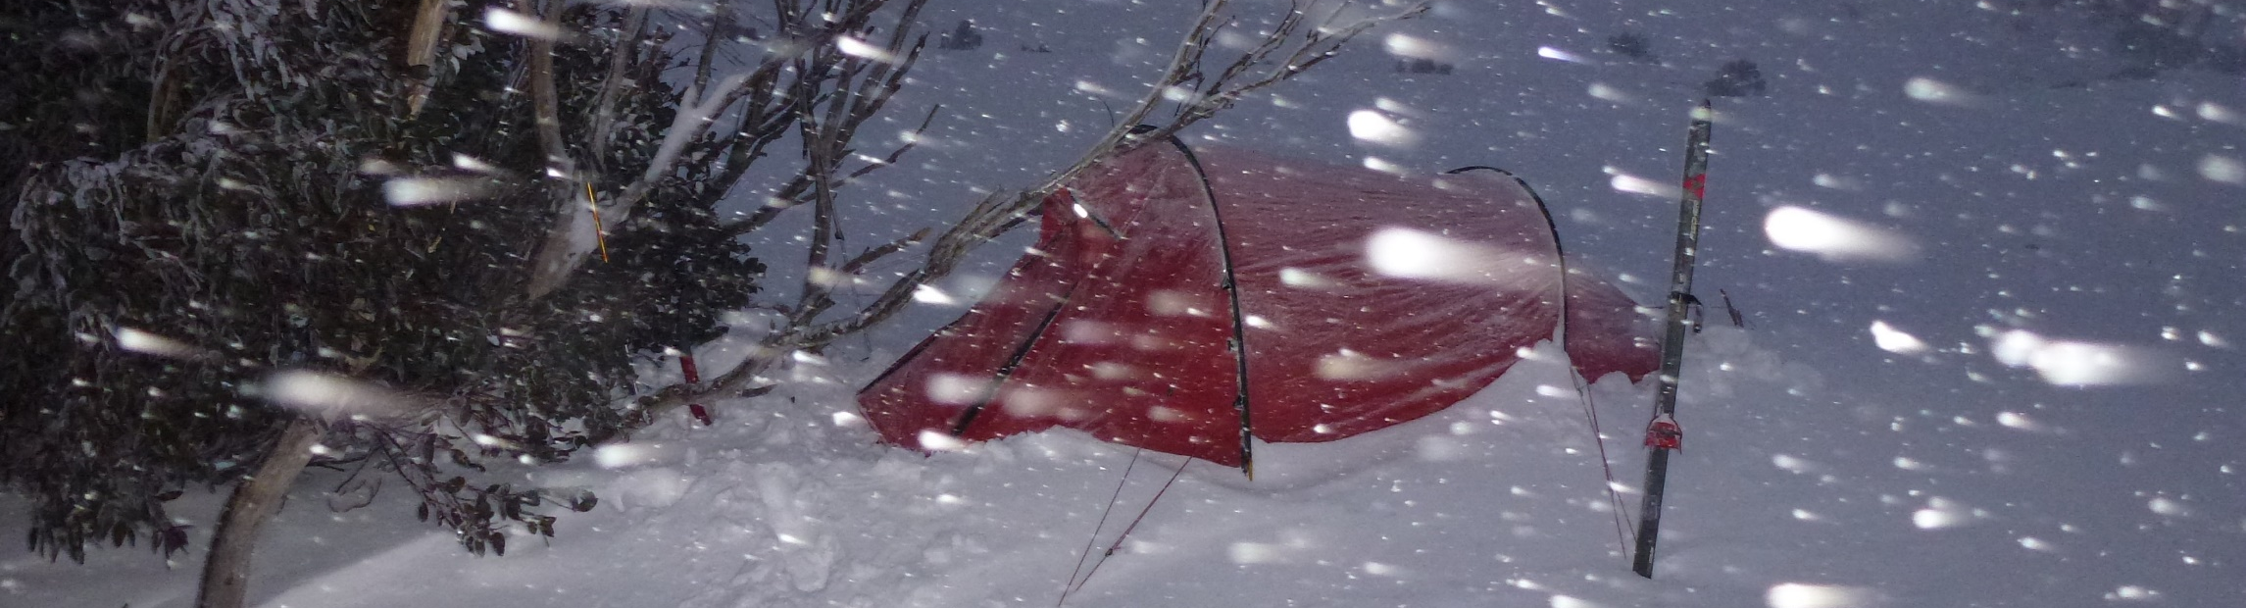
Earlier documents included:
A Risk Management Framework for the Confederation of Bushwalking Clubs NSW – 2004
Interim Guidelines for Member Clubs undertaking abseiling and skiing activities – Bushwalkers NSW 2005
Risk Management Guidelines – Bushwalking Australia – 2011 onwards
Notes:
We drew on a number of earlier documents - We would like to acknowledge the thought and effort that went into those earlier documents

Slide 4
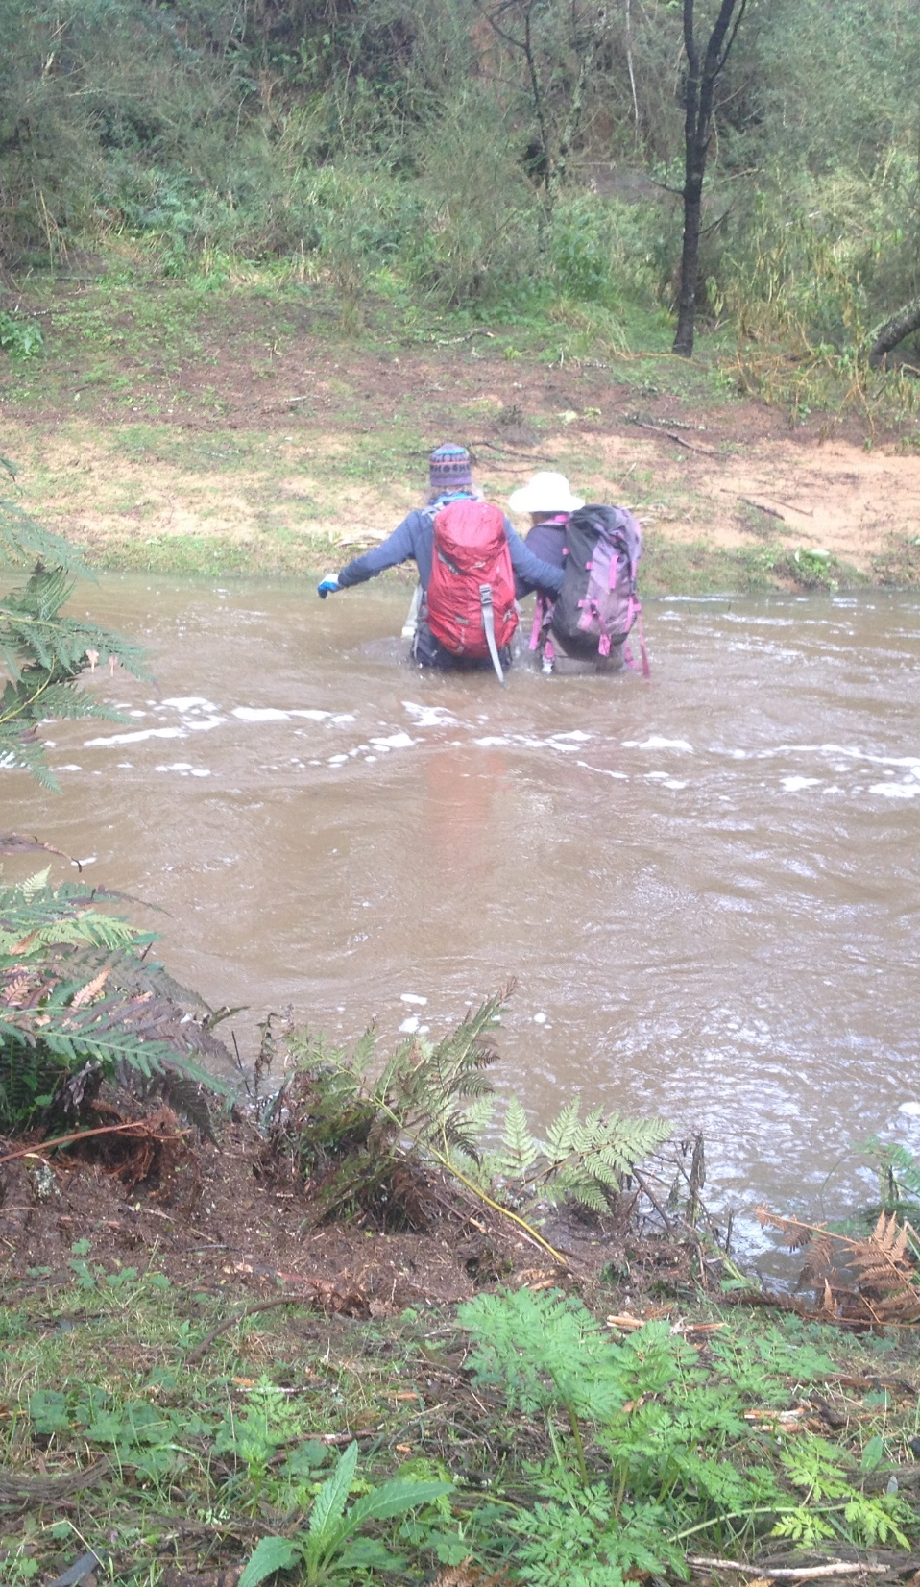
The new guidelines:
Consolidate and update the earlier documents
Give more detailed suggestions on how to draw up a Club Risk Management Plan
Give more examples of bushwalking-specific risks
Notes:
(In case anyone asks) Crossing Bells Creek in flood, Majors Creek State Conservation Area

Slide 5
Acknowledgement of Risks and Obligations forms:
  Annual
  For Members
  For Temporary Members Prior to Activity
  For both Members and Temporary Members, Prior to Activity
  For a Child
  For a Child and Authorisation of Responsible Adult for an Activity
Incident Report Form (example)
Member Emergency Contact and Medical Information (example)
Notes:
Forms. Rather than stipulate that Acknowledgement of Risks forms should be signed annually or per-activity, we designed forms for bother frequencies so Clubs can choose.
We also found that some Clubs like members and Temporary members to sign the same form; other clubs like separate forms. So we provide that choice as well.

Slide 6
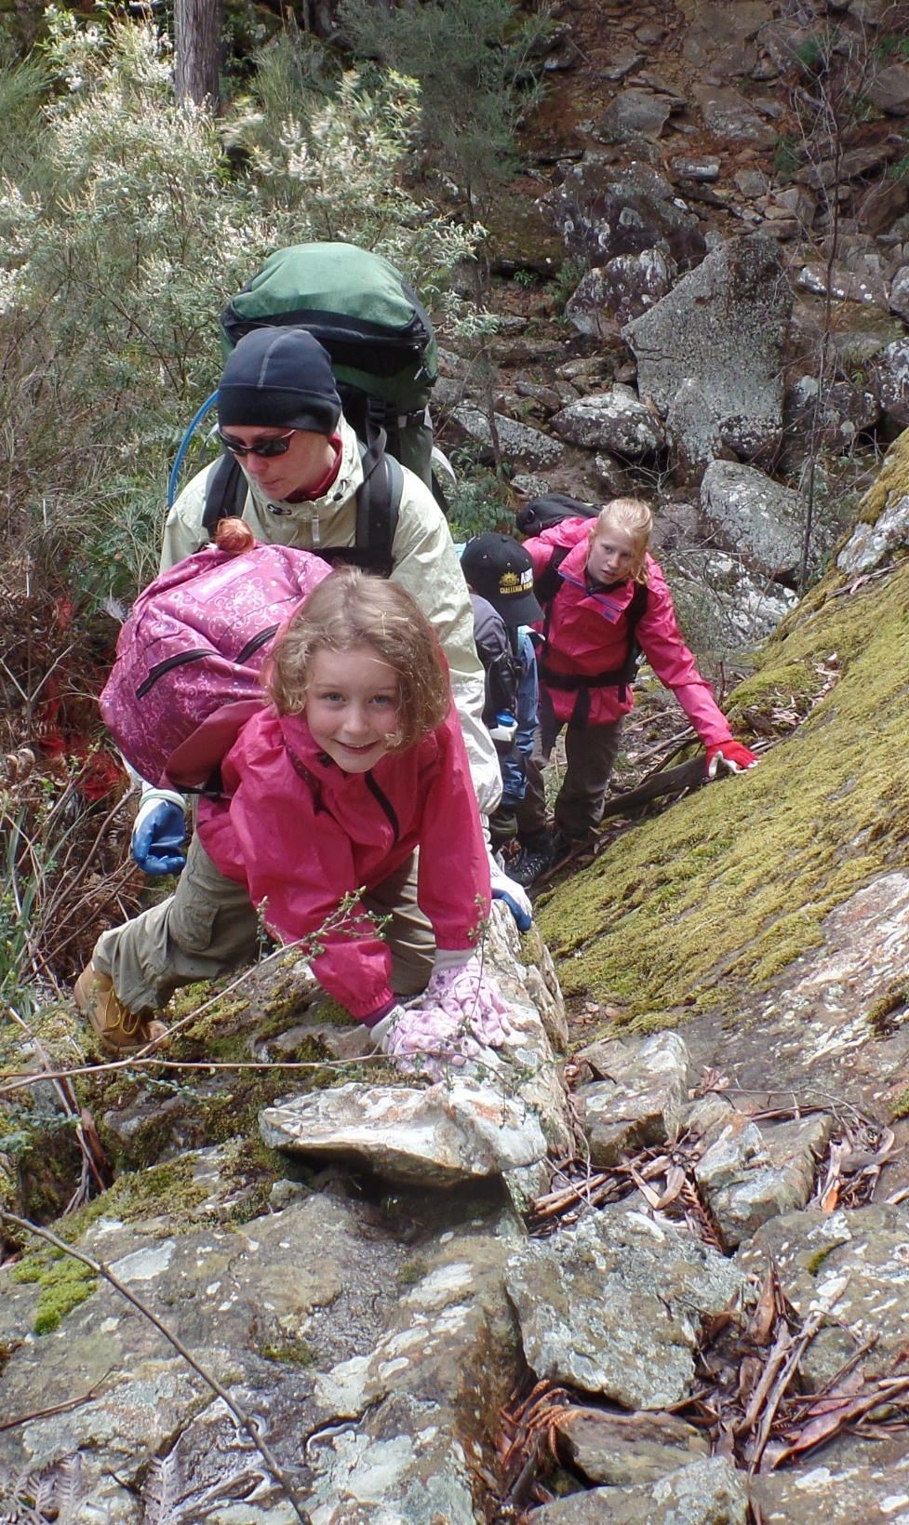
The new guidelines also give more information on ways to manage risks in activities:
With children
With people with disabilities
Notes:
In case anyone asks: Canberra Bushwalking Club family walk to Wave Cave, northern Budawangs

Slide 7
Questions?
Notes:
In case anyone asks: Rescue, Cape Howe Wilderness area, he made a full recovery and is no back to leading walks.

