Slide 1
BUSH SEARCH and RESCUE NSW
BSAR place in Emergency Services

Slide 2
BUSH SEARCH and RESCUE NSW is now part of the NSW State Emergency Service (SES) – why?

Slide 3
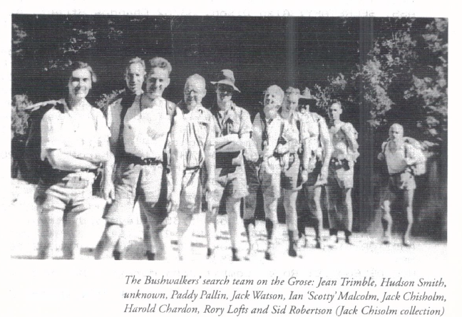
First BSAR search in October 1936

Slide 4
SOME BACKGROUND
The Search and Rescue Section of the NSW Federation of Bushwalking Clubs was officially established on 27 November 1936.
For many years the shorter name “Bushwalkers Search and Rescue” was in common use.
In 1969 Bushwalkers Search and Rescue was present at the foundation meeting / AGM of “The NSW Volunteer Rescue Association Inc.” (VRA)
In 1970 Bushwalkers Search and Rescue was accepted as an affiliate squad of the VRA at their first mid year conference.

Slide 5
The VRA
The NSW Volunteer Rescue Association Inc. (VRA) consists mostly of many small volunteer squads in country towns involved in road crash rescue. Please drive safely on country roads. These volunteers pride themselves on their prompt response to a road crash but it will not be the same as a paid rescue service ‘on standby’.
The role of the VRA is similar to other volunteer emergency services organisations. It is both the representative body for its affiliate squads to government plus ensures that squads have appropriate skills and level of training.
Bushwalkers Search and Rescue was one of a number of specialist VRA affiliate squads mostly based in the Sydney Region of the VRA that would often assist in search and rescue outside of this region. Examples of other specialist squads are NSW Cave Rescue and the radio squads WICEN and CREST.
See the VRA website at www.rescue.org.au

Slide 6
REMINDER –
In NSW the Police have the ‘charter’ as being “….. responsible for life and limb ….” This is a round about way of saying that land rescue in NSW is under the direction of NSW Police.
Further, the role of all other Emergency Services has been defined as the result of recent reviews of search and rescue in NSW.
The informal Bushwalkers Search and Rescue became “Bushwalkers Wilderness Rescue Squad Inc.” (BWRS) on 16 February 2001. The rescue environment was changing with these above reviews. A fixed membership was essential to indicate that BWRS volunteers had the necessary required skills (competencies). BWRS is not unique. All emergency services must now keep records of member skills from “Competency Based Training” (CBT).

Slide 7
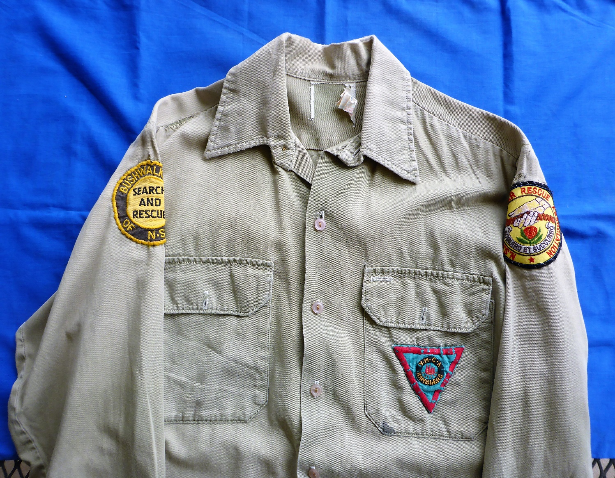
The first uniform of BSAR in mid 1980s for Committee Members – so what did bushwalker volunteers wear? You guessed it; shorts and volleys!

Slide 8
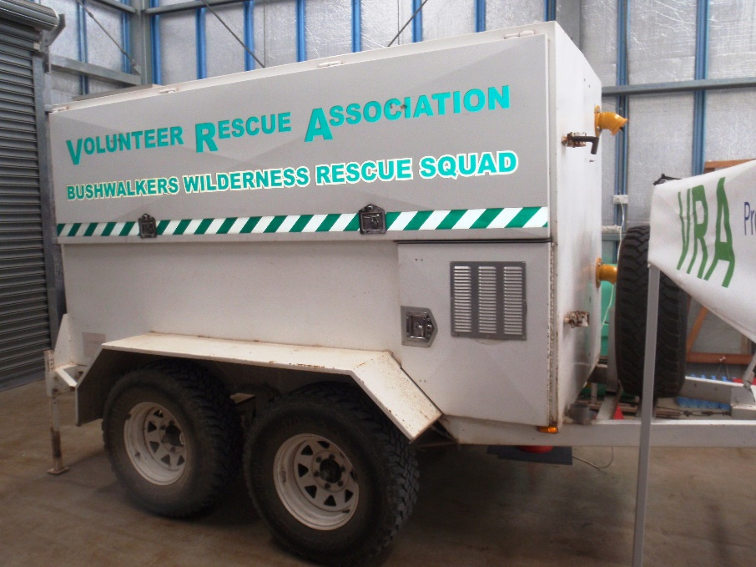
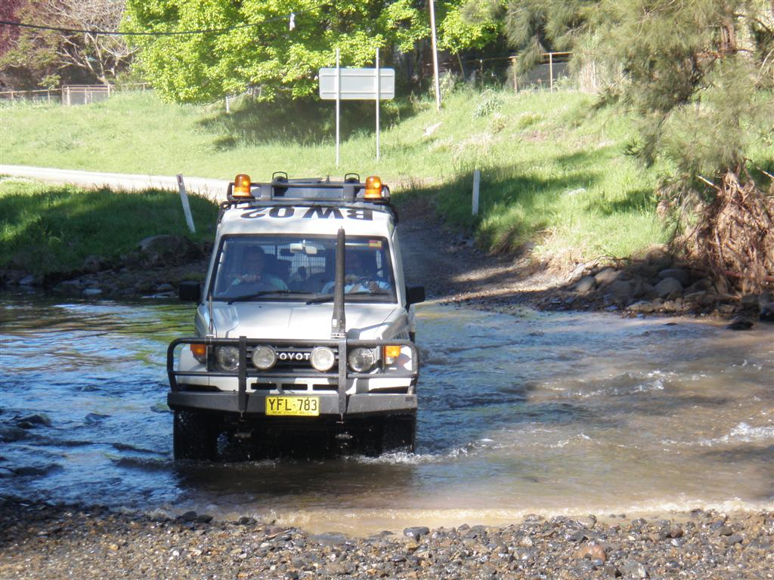
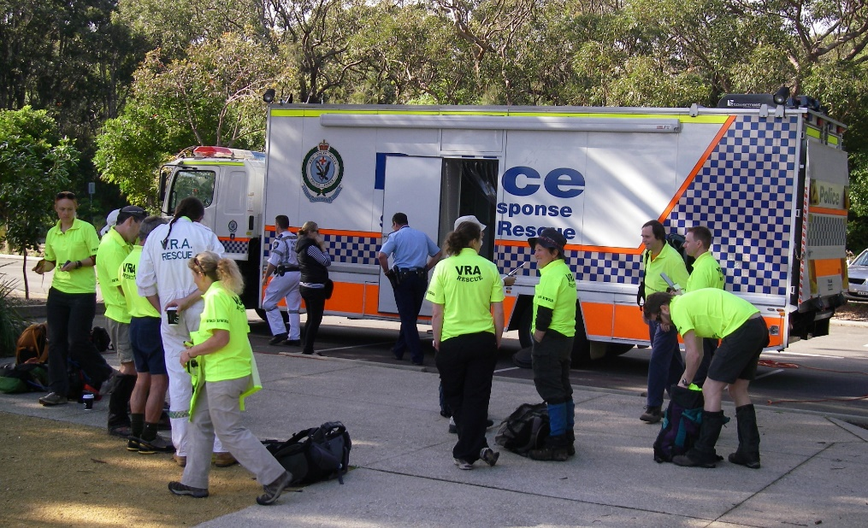
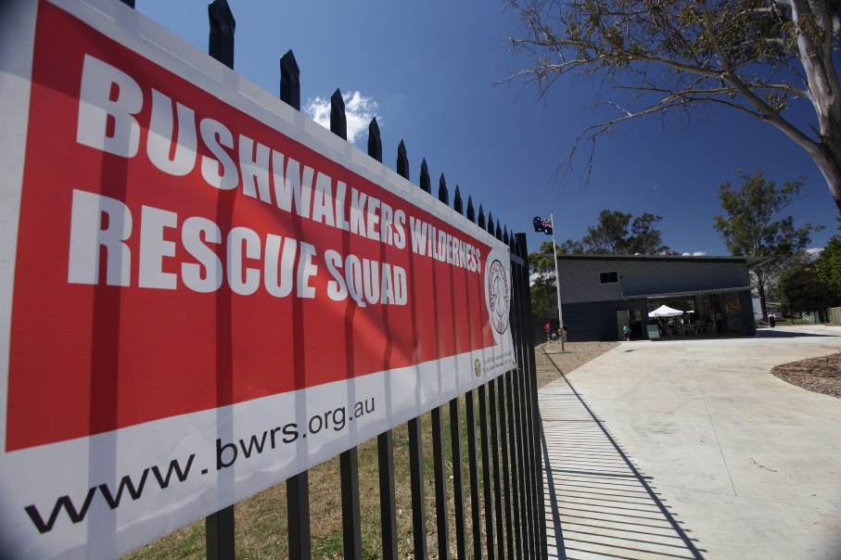
Some assets for a modern volunteer remote area S & R squad

Slide 9
FUTURE CHALLENGES for BSAR
There are two major inter-related challenges; finance (ie annual running costs) and active involvement in volunteer search and rescue
Fundraising activities were draining member resources and enthusiasm

Slide 11
In recent times a large proportion of activities by SES (as requested by NSW Police) were similar to the community service offered by BSAR. “Volunteering Reimaged” is the SES response to better fulfill this type of task.

Slide 12
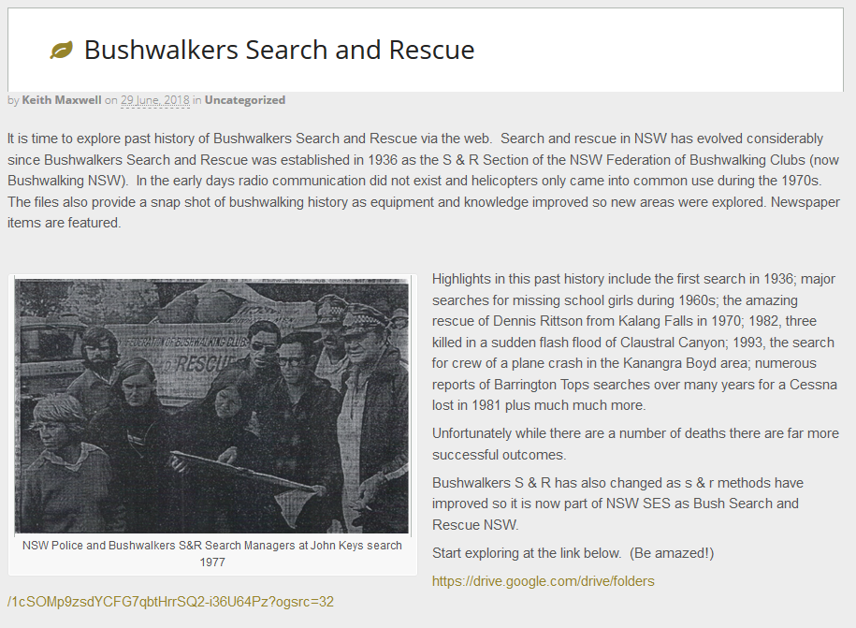
Where can I find more information on Bush Search and Rescue NSW history??

Slide 13
REGRETS?

